Slide 1

CS3503 – Machine Learning PBL
Project Review
SENTIMENT ANALYSIS
Presentation by
Sagar Arun (210425205150)
Sampath Bala RK (210425205153)
Information Technology
Mentor
Dr. Nithya Baskaran
Associate Professor
Information Technology

Slide 2
Problem & Objectives
Problem Statement
Online reviews and feedback can be difficult to interpret accurately, especially when users express sarcasm or mixed emotions.
Businesses, reviewers, and organizations that rely on feedback analysis are affected by this problem.
Misinterpreting sentiment or sarcasm can lead to wrong conclusions about customer opinions and satisfaction.
Therefore, analysing sentiment, emotions, sarcasm, ratings, and user behaviour together helps provide more meaningful feedback insights.
Objective
Identify / analyse review text, sentiment, emotions, sarcasm, and rating patterns.
Develop a local web application for real-time and batch feedback analysis.
Apply ML to classify sentiment and detect sarcasm using text and stylistic features.
Evaluate and improve prediction accuracy using user history, rating mismatch, and explainable analysis.
Expected Outcome
Analyses sentiment, emotions, and sarcasm from user reviews.
Combines text, star ratings, and behaviour history for prediction.
Provides real-time and batch analysis through a local web application.

Slide 3
Input, Analysis & Insights
Input/ Data Sources
Review / feedback text entered by the user.
Star ratings associated with the reviews.
User IDs and behavioural history from previous analyses.
Textual and stylistic features such as punctuation, capitalization, and sentiment-rating mismatch.
Analysis/ Processing
Preprocess the review text by extracting textual and stylistic features such as words, punctuation, capitalization, and sentiment signals.
Combine multiple inputs including review text, star ratings, sentiment scores, and user behavioural history.
Apply ML models using TF-IDF, VADER, and Logistic Regression to predict sentiment and sarcasm; the advanced engine can also use transformer models for sentiment and emotion.
Generate and interpret results such as sentiment, emotion, sarcasm probability, rating mismatch, and explainable token highlights.
The system improves sarcasm detection by considering sentiment–rating mismatch and writing style, rather than relying only on the review text.
Key Insights
Positive, negative, and neutral sentiments can be identified from review text.
Sarcasm can cause sentiment-rating mismatches, making simple sentiment analysis less reliable.
Punctuation and writing style provide useful signals for detecting sarcasm.

Slide 4
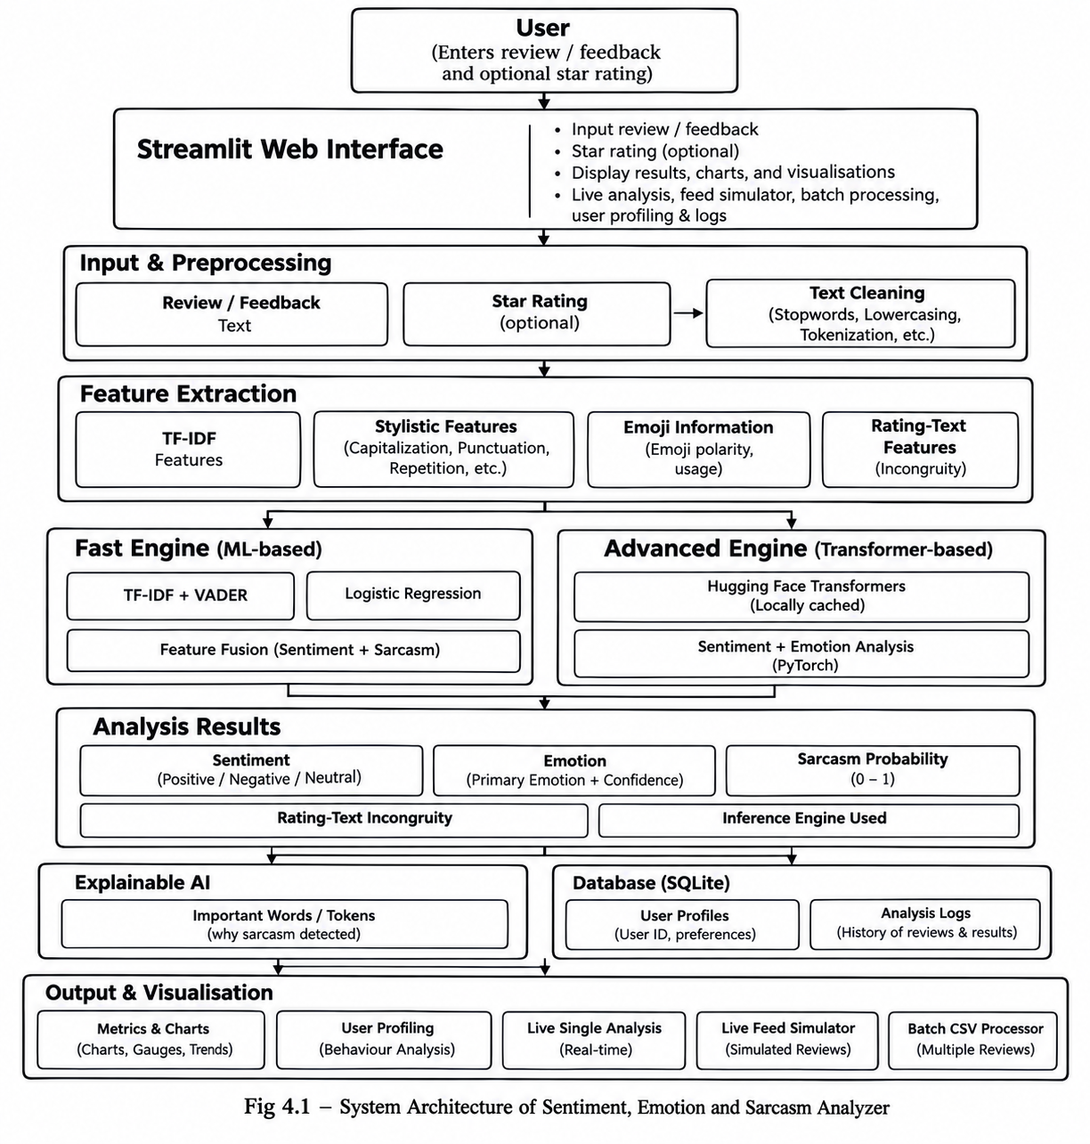
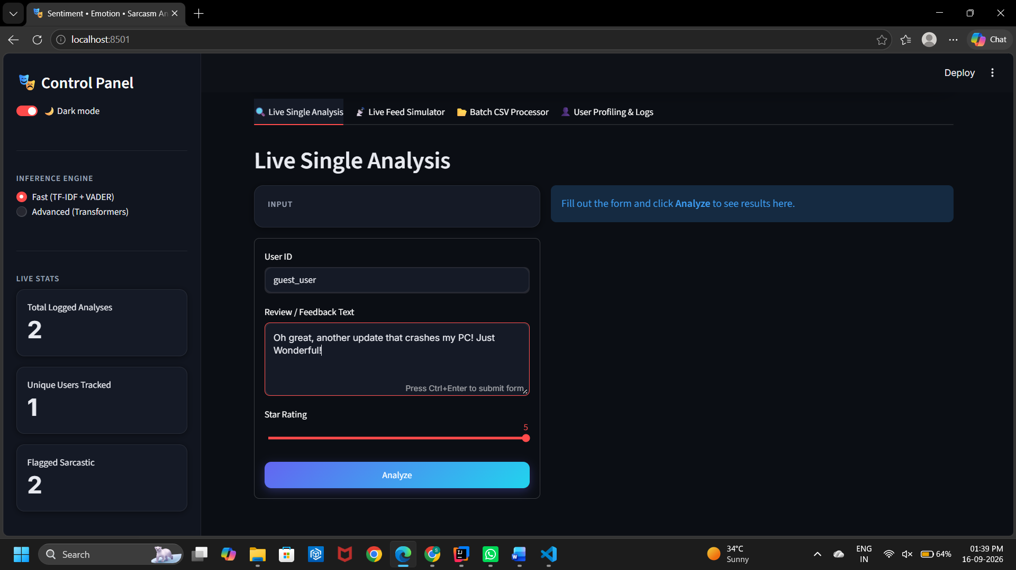
Technical Approach
Architecture
.
Technology Stack
Programming Language: Python
Framework: Streamlit for the web application interface.
Machine Learning: Scikit-learn (TF-IDF + Logistic Regression) and VADER for sentiment analysis.
Advanced ML: Hugging Face Transformer models for sentiment and emotion an
Database: SQLite for storing users and sentiment analysis logs.
Other: Pandas/CSV processing, CSS for UI styling, and locally stored pre-trained ML model files.
ML Methodology and Implementation Process

Slide 5
Feasibility, Risk and Challenges
Feasibility
Feasibility Point 1: The application can run locally on a computer without requiring external API keys
Feasibility Point 2: Pre-trained ML models are already included, allowing the system to start without mandatory retraining.
Feasibility Point 3: SQLite provides simple local storage for users and sentiment analysis logs.
Feasibility Point 4: The Streamlit interface supports real-time, batch CSV, and user-profile analysis, making the system practical for different use cases.
Risk and Challenges
Sarcasm detection: Sarcastic language is complex and can be difficult for ML models to classify accurately.
Ambiguous reviews: Mixed or unclear emotions may lead to incorrect sentiment predictions.
Rating mismatch: A review’s text may not match its star rating, making interpretation challenging.
Model limitations: The Fast Engine relies on synthetic training data, which may not represent all real-world reviews.
Advanced model dependency: The Advanced Engine requires a one-time download of transformer models and may require significant storage.
User-history limitations: Limited user history may reduce the accuracy of behavioural profiling.
Data quality: Poorly written, very short, or noisy feedback can affect analysis results.
Privacy: Since user IDs and analysis history are stored in SQLite, appropriate care is needed when handling user data.
Mitigation
Use multiple features such as text, ratings, punctuation, and user history to reduce misclassification.
Use pre-trained ML models and feature fusion to improve prediction reliability.
Provide explainable results and rating-mismatch warnings to help users understand predictions.
Keep the system local and offline to reduce dependency on external APIs and services.

Slide 6
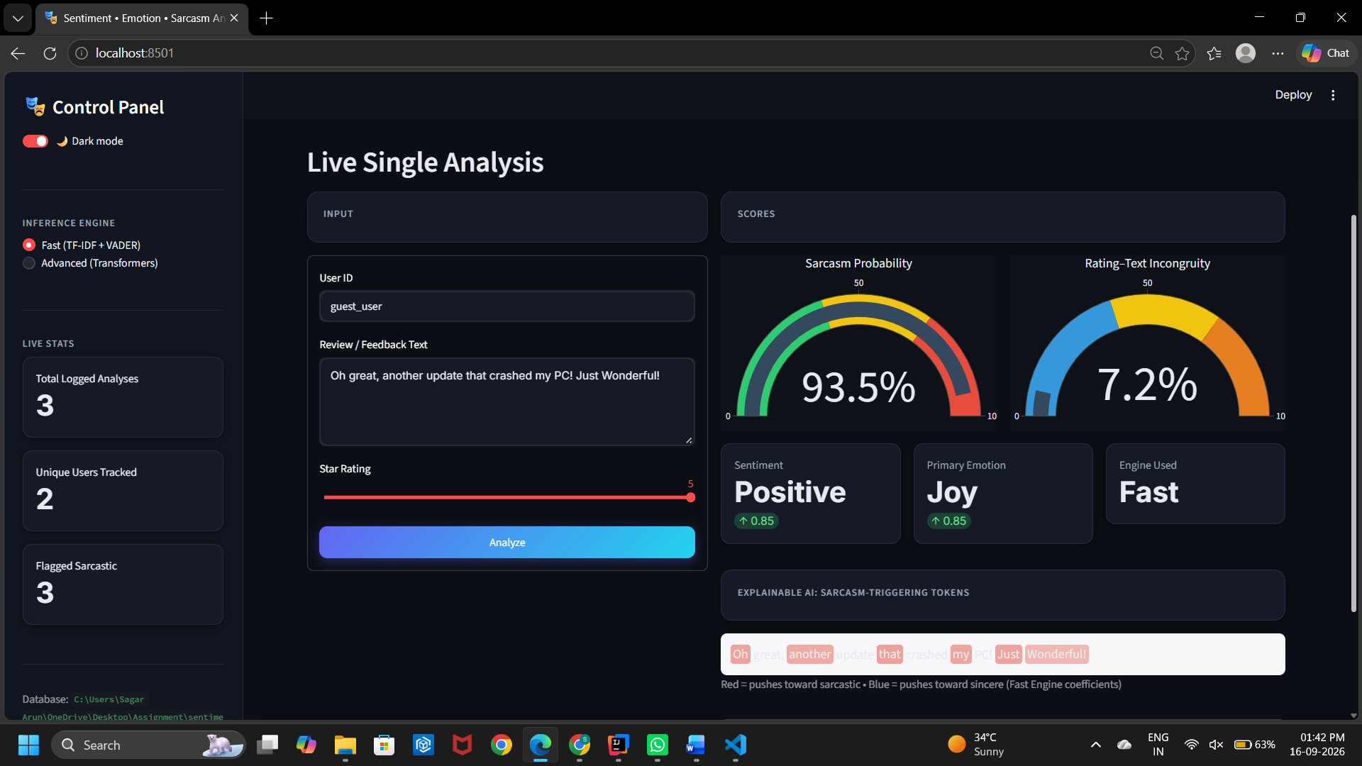
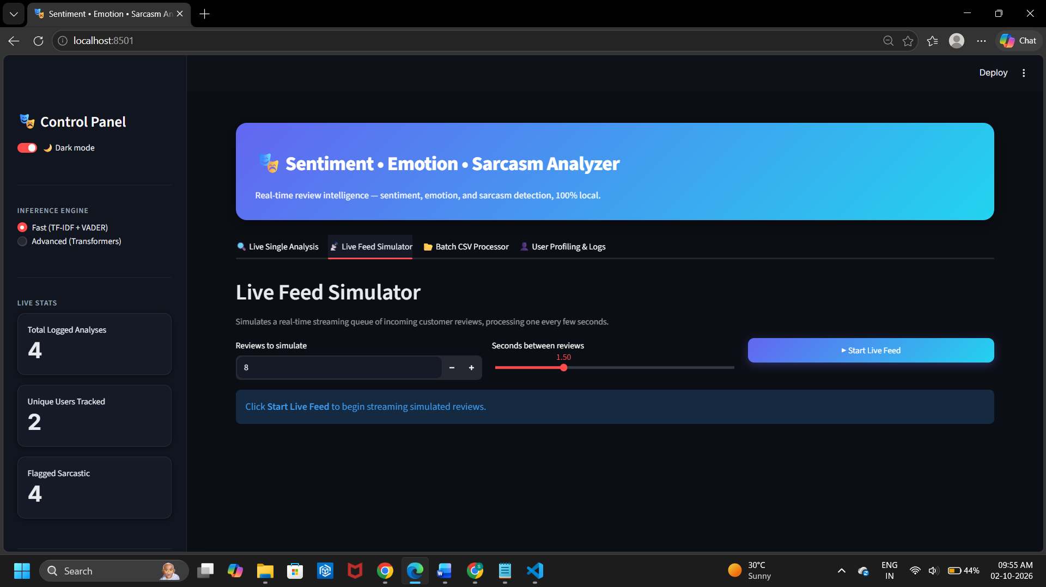
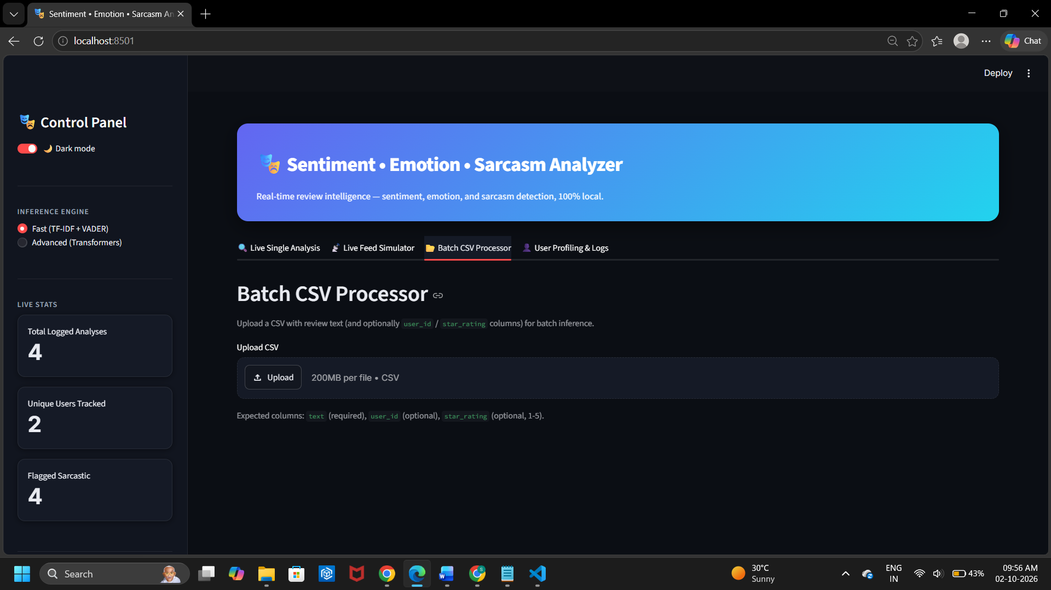
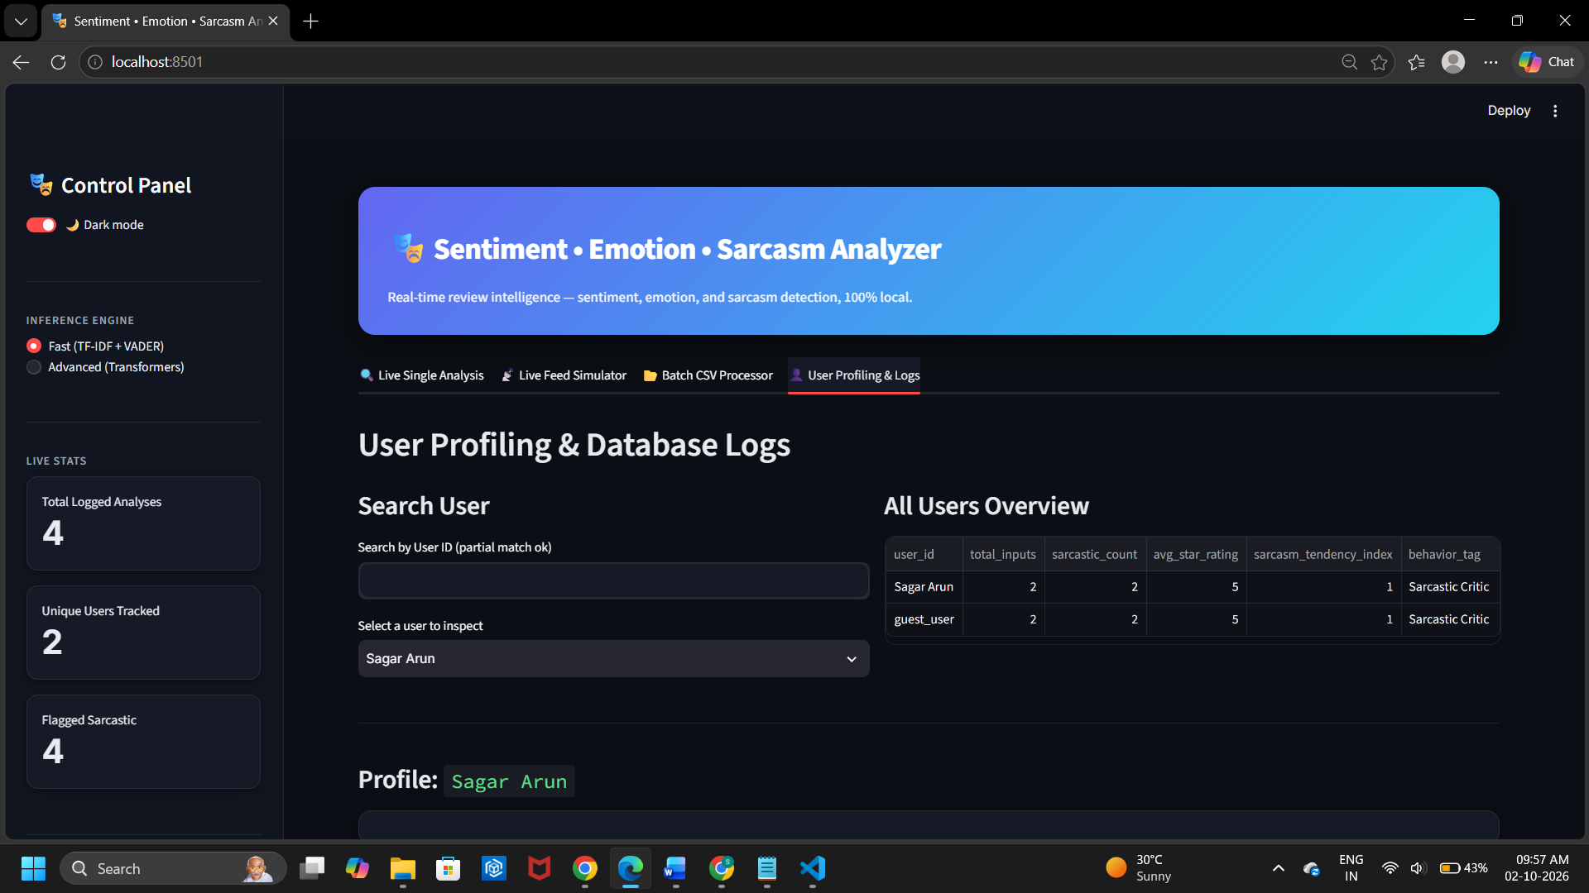
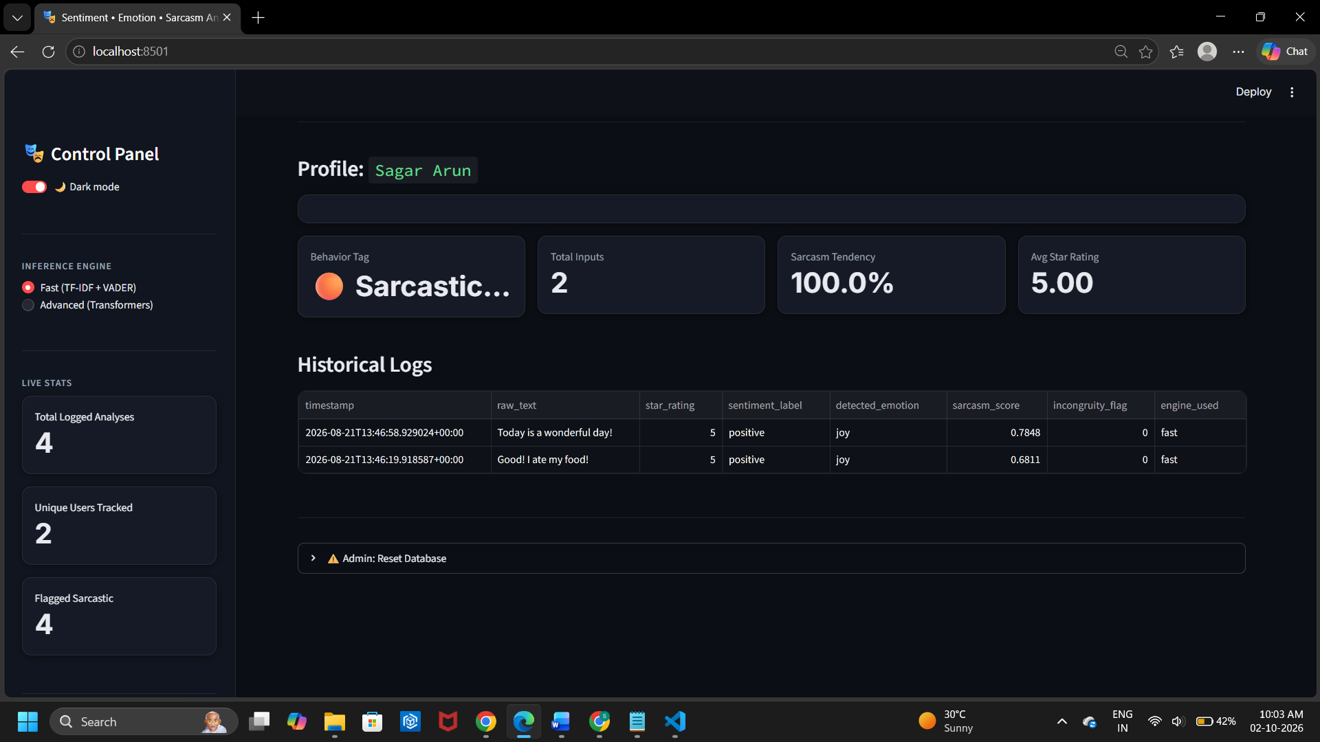
Result and Applications
Project Output
Applications
Customer Feedback Analysis, E-commerce Platforms, Business & Brand Monitoring, Social Media Analysis

Slide 7
Conclusion, Limitations & Future Scope
Conclusion
We developed a machine-learning-based Sentiment, Emotion, and Sarcasm Analyzer using Python, Streamlit, TF-IDF, VADER, Logistic Regression, and local transformer models to address the challenge of accurately understanding online reviews and feedback.
The system analyses sentiment, emotions, sarcasm probability, star ratings, and user behaviour.
It provides real-time and batch feedback analysis through a locally running web application.
The solution demonstrated potential for customer feedback analysis, business decision-making, and service improvement.
Its local, offline design makes it practical, privacy-conscious, and independent of external API keys.
Limitations
Dataset size / quality: The Fast Engine is trained using synthetic data, which may not fully represent the variety of real-world reviews.
Limited real-world validation: The project does not provide extensive validation results on large, diverse real-world datasets.
Model constraints: Sarcasm detection relies on handcrafted stylistic features and a trained classifier because there is no reliable off-the-shelf local sarcasm transformer used in the project.
Future Scope
Larger real-world datasets: Train and validate the models using large, diverse, and continuously updated review datasets.
Multilingual support: Extend the system to analyze reviews in multiple Indian and international languages.
Improved sarcasm detection: Develop more advanced deep-learning models specifically for detecting sarcasm and contextual expressions.

Slide 8



Project Video Link
Add the Direct URL/Drive link of your project in voice over video
GitHub Repository Link
Add GitHub Repo link of your project
Sagar Arun, Sampath Bala R K
Information Technology
GitHub Repository

